Slide 1
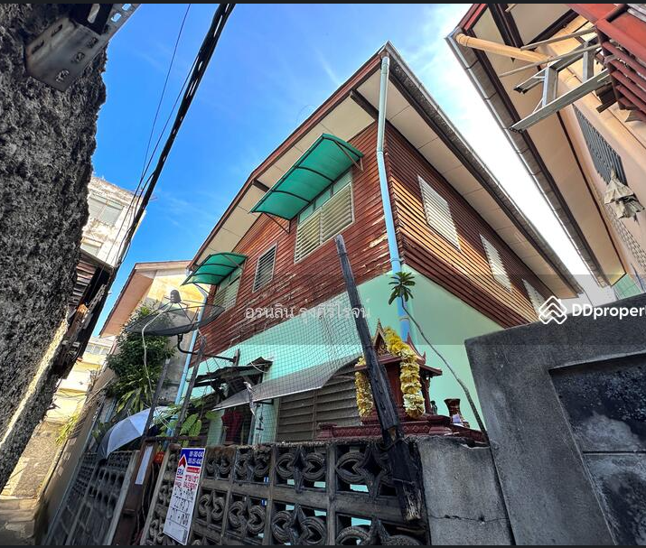
Legacy Property Assessment: Value Optimization Strategy

Slide 2
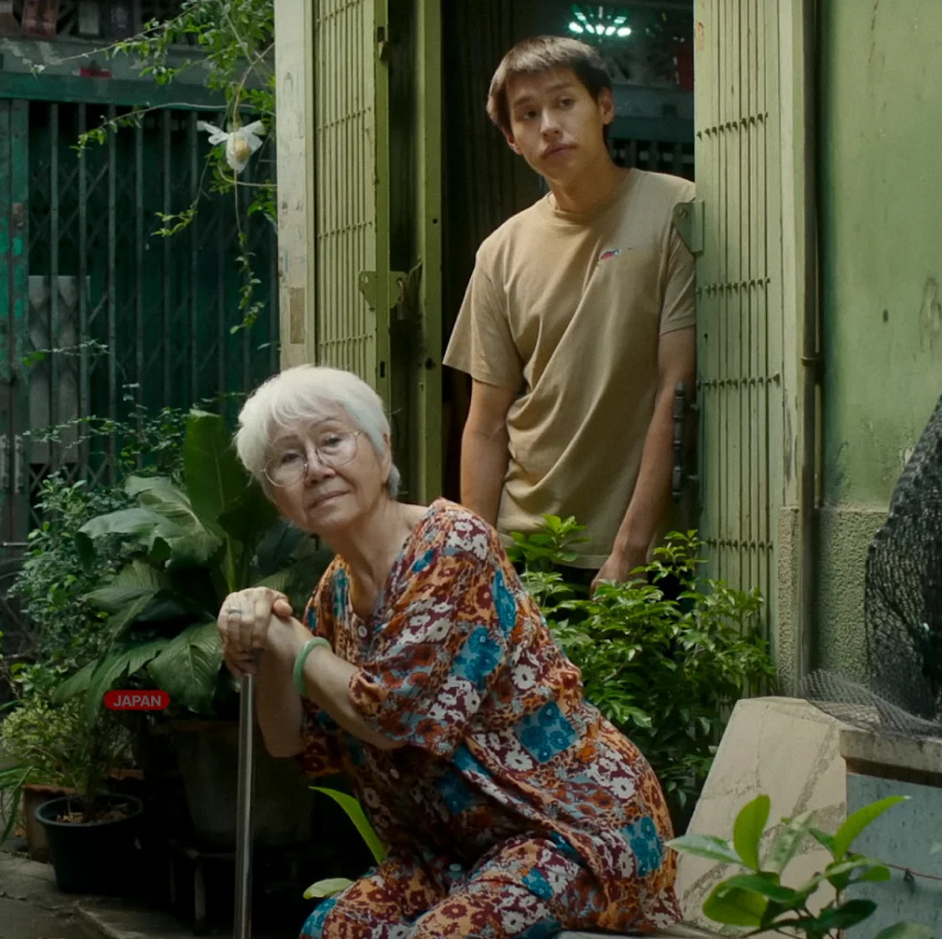
Problem statement
How can we optimize the value of a legacy residential property?
How to make million before grandma dies, 2024

Slide 3
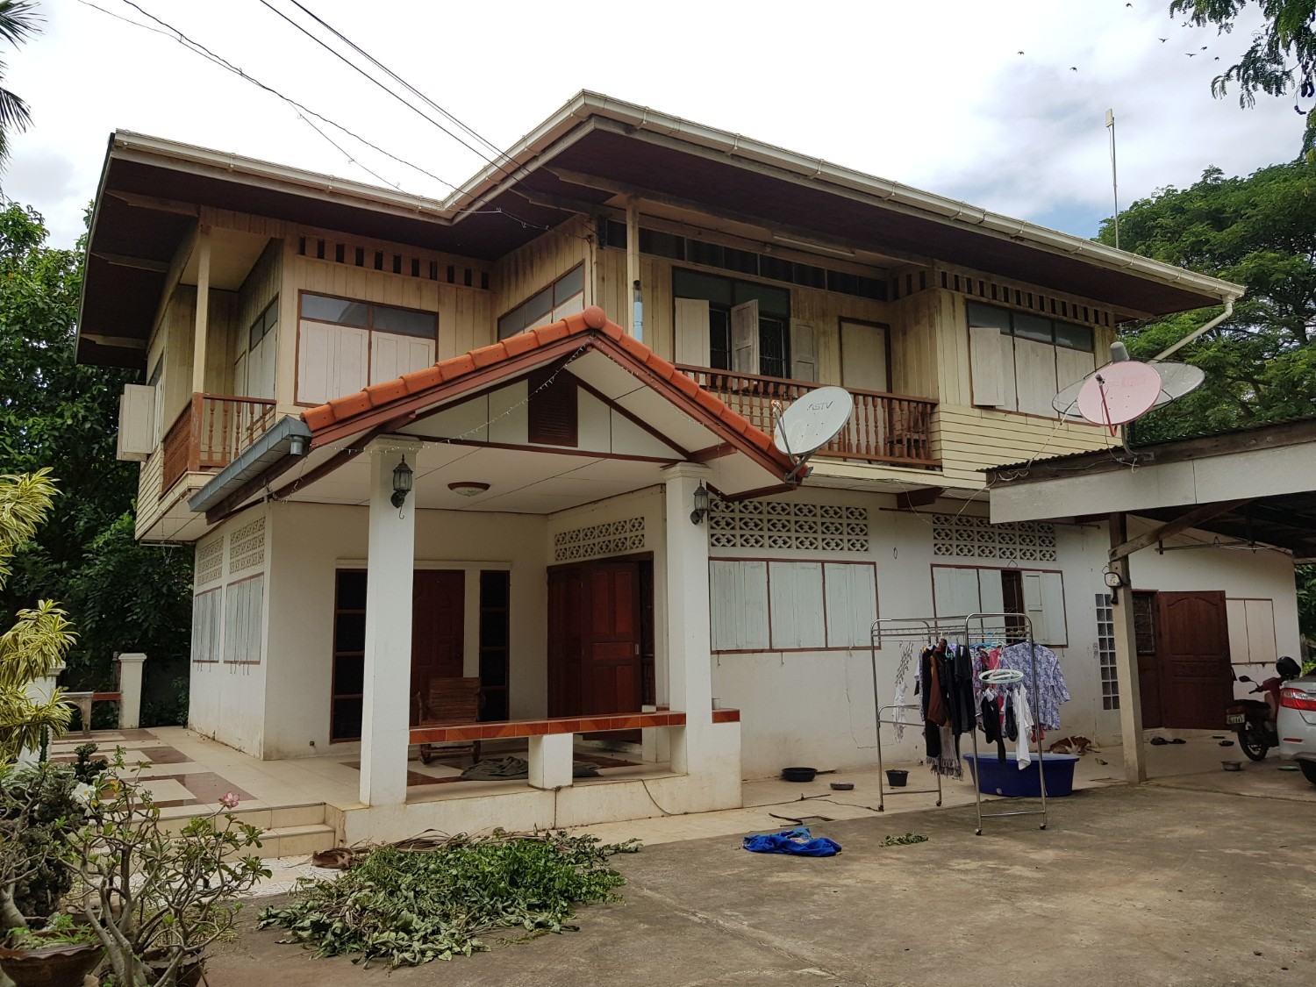
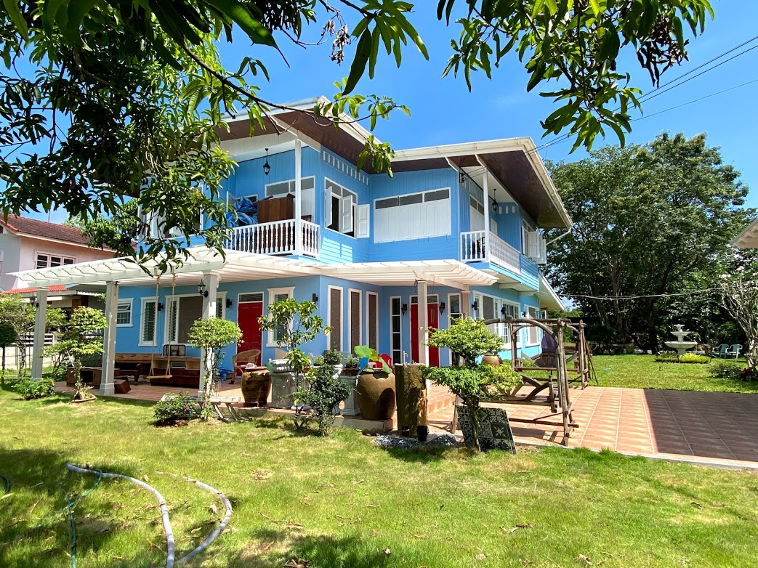
?
Imagine this:
You inherited a detached legacy house that you didn’t plan to move into. Would you sell it immediately, or would you rebuild/renovate it first?

Slide 4
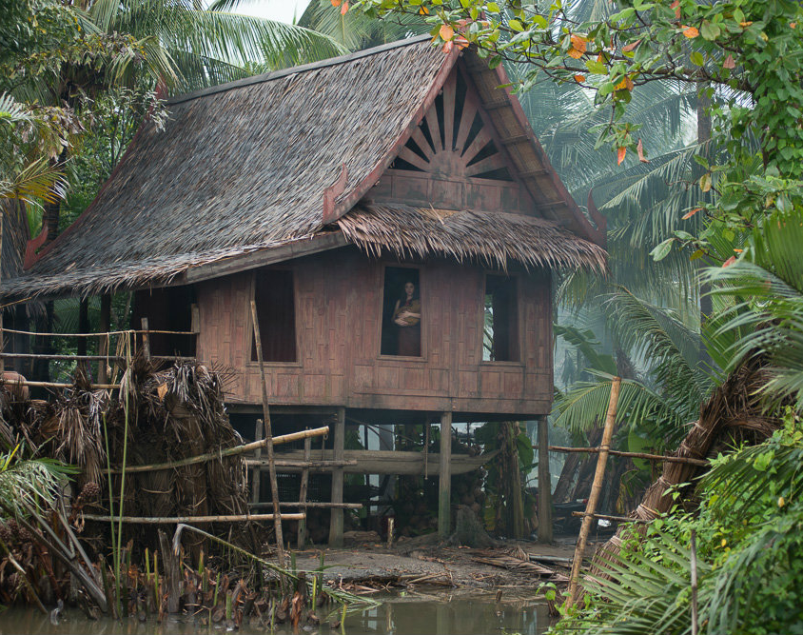
System
Factors Influencing Housing Prices
Property-specific attributes that owners can control or modify, such as the layout, renovations, and overall condition of the property
2,600,000 Baht
Unknown-Aged Detached House
in Bangkok Phra Khanong
Floor Area 70 m²
Land Area 100 m²
1 Bedroom 1 Bathroom
Environment
External factors that are out of the owner's control but affect a property's appeal. This includes amenities like nearby supermarkets, schools, parks, and other facilities that enhance the location's desirability.

Slide 5
Factors Influencing Housing Prices
Environment
Location
Province & District
Nearby Station
Facilities & Amenities

Slide 6
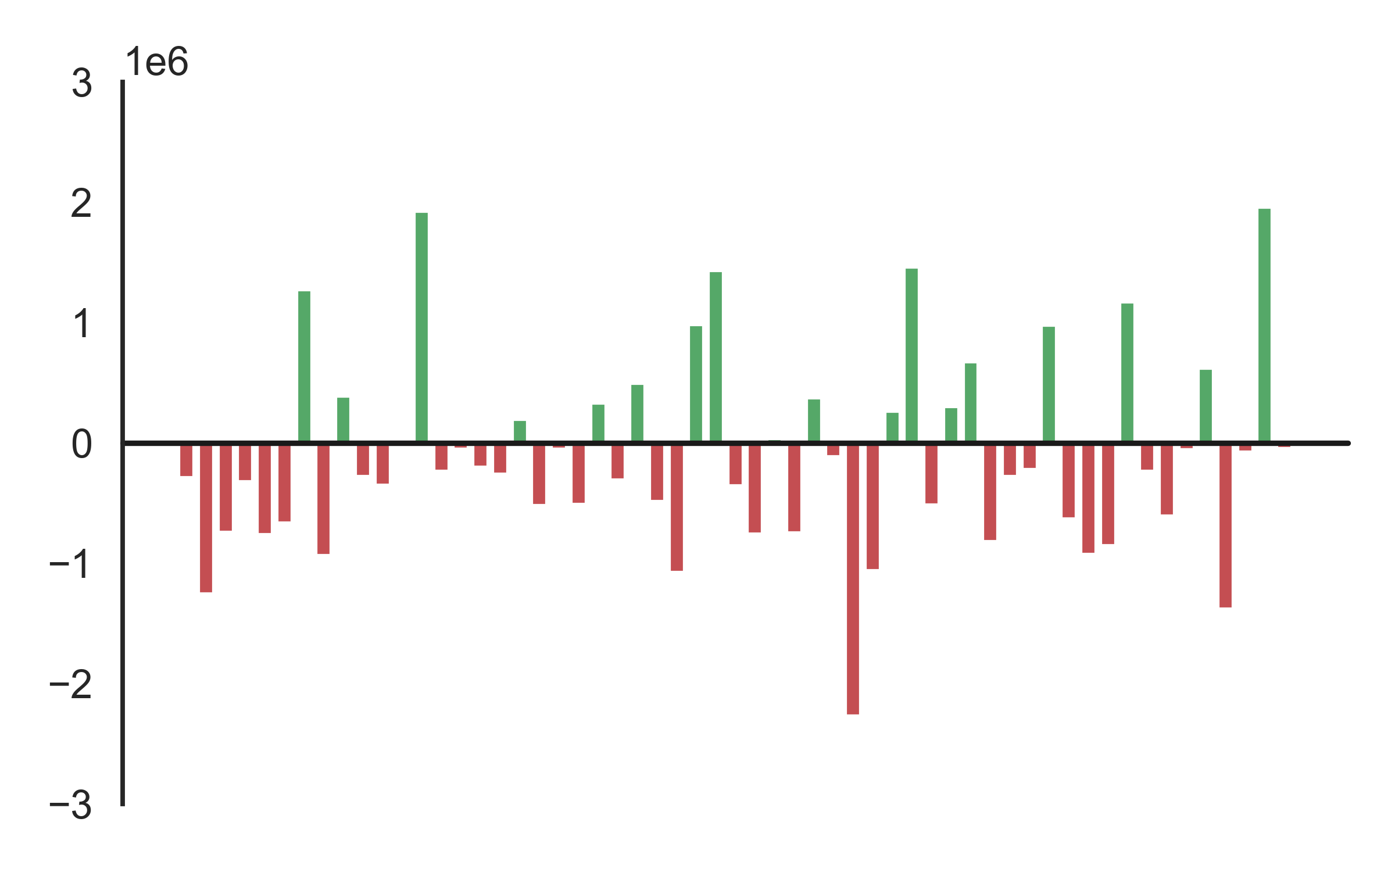

Factors Influencing Housing Prices
Relative Price Difference to Phra Khanong
Watthana
1.96m
Location – Province & District
Bang Bon
-1.26m
Thung Khru
-1.38m
Relative Price Difference to Bangkok
Nonthaburi: -836k
Samut Prakan: -776k
Nong Chok
-2.27m

Slide 7
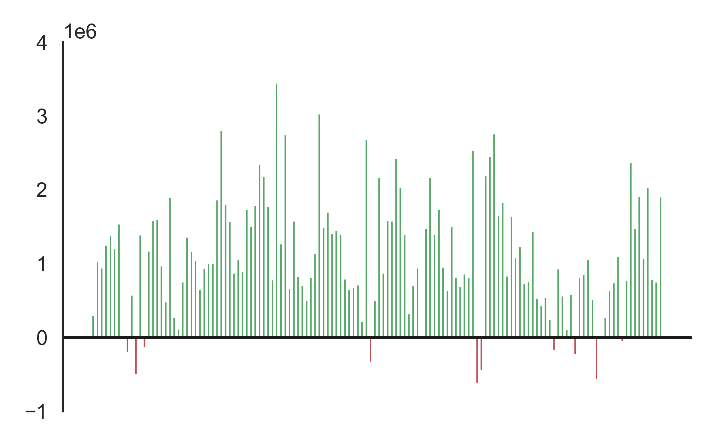


Factors Influencing Housing Prices
Relative Price Difference to no nearby station
Location – Nearby Station
Relative Price Difference to no nearby station
N20 Saphan Mai BTS: -624k
BL26 Silom MRT: 3.45m
Price increases 115k per 1 nearby station
Price decrease 120k per 100 meters farther from nearest station
+115k per station
-120k per 100 meter

Slide 8



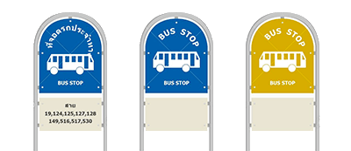
Factors Influencing Housing Prices
+10k per supermarket
Location – Facilities, Amenities
+185k if there are bus stops

Slide 9
Factors Influencing Housing Prices
System
Attributes
Land Area & Floor Area
Bedrooms & Bathrooms
Year Built

Slide 10
Factors Influencing Housing Prices
Roof
Floor Area 2
Floor Area 1
Land Area
Extra
Land Area & Floor Area
Extra
Land Area: The total surface area of the plot on which the property stands, including open spaces and boundaries
Floor Area: The usable indoor area within a building, measured across all floors, typically excluding external walls and non-livable spaces
Extra 10% Land Area ≈ 61k
Extra 100% Land Area ≈ 442k
Extra 10% Floor Area ≈ 143k
Extra 100% Floor Area ≈ 1.04m

Slide 11


Baths
Factors Influencing Housing Prices
3
3.38m
3.35m
3.32m
2
2.41m
2.55m
2.69m
Bedrooms and Bathrooms
1
1.45m
1.76m
2.07m
Bedrooms and bathrooms both influence property value, but baths tend to have a bigger impact.
Interestingly, the negative effect of the bedroom-bathroom combination means that having too many bedrooms or bathrooms can lower the property value, showing that adding more doesn’t always increase worth.
1
2
3
Bedrooms

Slide 12







1.1m
Factors Influencing Housing Prices
600k
Before 2001
2001-2005
2006-2010
55k
-89k
Unknown
Year built
2011-2015
2016-2020
After 2021
Overall, newer builds, particularly from 2016 onward, tend to strongly increase property values, while older constructions, especially pre-2000, have a negative impact.
-656k
-894k

Slide 13
Gaining Housing Prices
2
Build New Stories
From 1 to 2 ≈ + 1.04m
From 1 to 3 ≈ + 1.64m
From 2 to 3 ≈ + 607k
Buy Adjacent Land
+ 10% ≈ + 61k
+ 20% ≈ + 116k
+ 30% ≈ + 167k
+ 40% ≈ + 214k
+ 50% ≈ + 258k
1
Strategy
Increase land area
Increase floor area
Increase bathrooms
Benefit from rebuilding
2
Home Extension
+ 10% ≈ + 143k
+ 20% ≈ + 273k
+ 30% ≈ + 392k
+ 40% ≈ + 504k
+ 50% ≈ + 607k
3
Increase 1 bathroom
≈ + 97k
4
Benefit from rebuilding ≈ + 55k to 2m

Slide 14
Decisions
Increase land area = G1
Increase floor area = G2
Increase bathrooms = G3
Benefit from rebuilding = G4
Total Gain = G1 + G2 + G3 + G4
Cost = Cost from building, purchasing a land, interest, time, and opportunity cost
If Total Gain > Cost, it is worth to do.

Slide 15

Nevertheless
The investment carries risks; the investor should do their research before investing.
Thank you for your listening.

